Slide 1
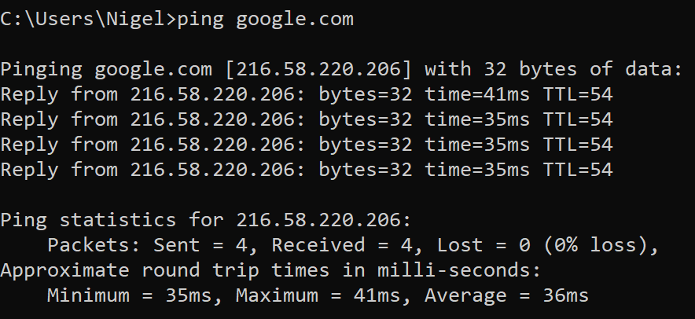
NLP USE CASE: EXTRACTION

Slide 2
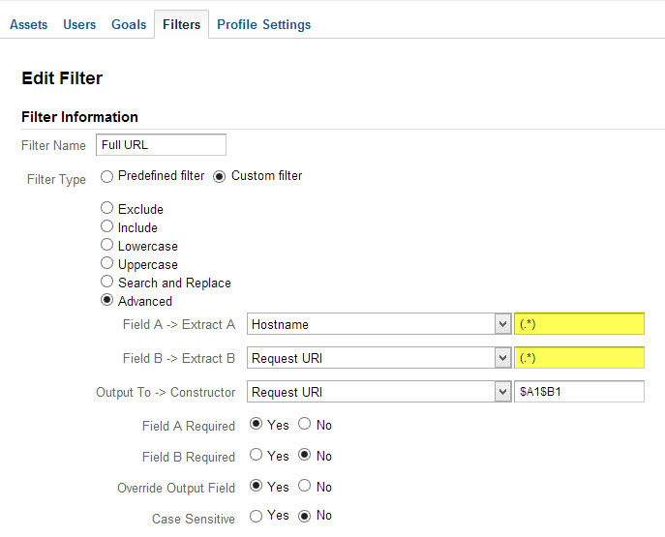
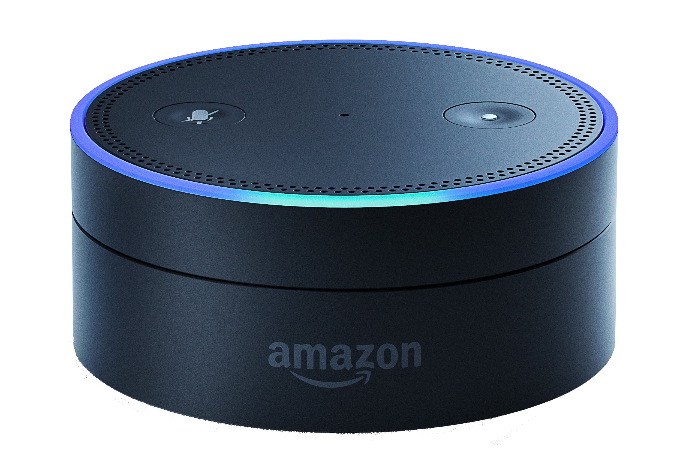
NLP USE CASE: RULE BASED QUERY

Slide 3
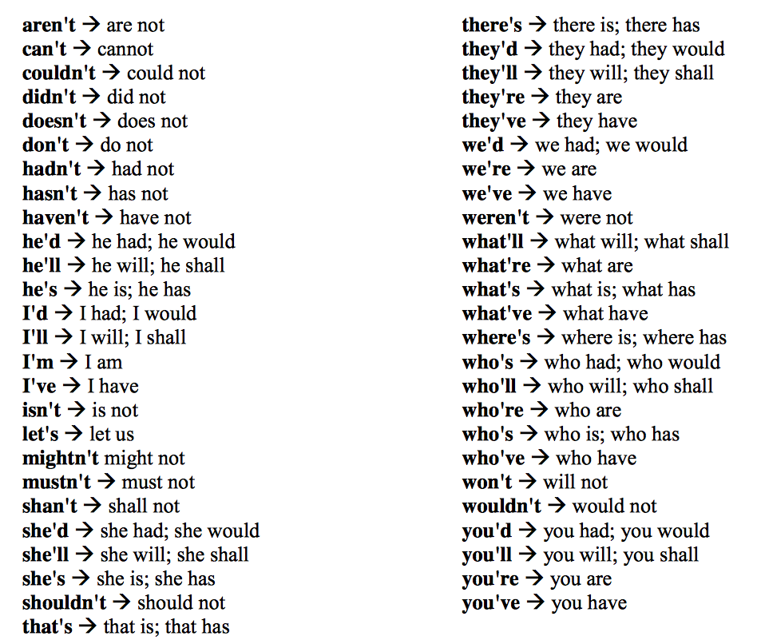
NLP USE CASE: CLEANING

Slide 4
Regular Expressions
By: Nigel Silva

Slide 5
Language
Set of strings made up of characters from a specified alphabet
alphabet = set of symbols
Regular Language
A subset of all strings that has a certain pattern.
A language that can be expressed by a Finite State Machine (FSM) or Regular Expression (RegEx).

Slide 6
10.18.2.111
192.168.1.1
192.168.252.111

Slide 7
10.18.2.111
192.168.1.1
192.168.252.111
Regular Language

Slide 8
10.18.2.111
192.168.1.1
192.168.252.111
Regular Language
RegEx
FSM

Slide 9
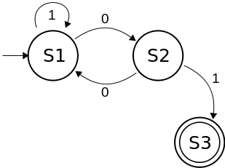
Finite State Automaton (Machine)
Computation model used to simulate sequential logic.
Visualized as a graph & can be implemented as either hardware or software.
START
ACCEPT

Slide 10
FSM Representations (Formal vs Graphical)
M = (Q, ∑, δ, q0, F)
Q: finite set of states
∑: finite set of inputs (aka alphabet)
δ: transition function (δ: Q × ∑ → Q)
q₀: initial state
F: is a set of accepting state/states
START
ACCEPT

Slide 11
Regular Language and FSM
A finite state machine M, describes a regular language L.
where L is a set of words {w_{o}, w₁, …, w_{n}}.
w = sequence of inputs from an alphabet ∑
M accepts a string w if and only if M starts in the initial state (q₀), undergoes a series of state transitions that ends in an accepting state (F).
M recognizes L if all the words of L are accepted by M.
START
ACCEPT
M = (Q, ∑, δ, q0, F)
Q: finite set of states
∑: finite set of inputs (aka alphabet)
δ: transition function (δ: Q × ∑ → Q)
q₀: initial state
F: is a set of accepting state/states

Slide 12
Example Problem 1
Let:
∑ (alphabet) = {a, b}
Q₀ (initial state) = S0
Create an FSM that matches a string that ends with “ab”.

Slide 13
Example Problem 1: FSM
Simulate inputs:
{a, b, aa, ab, ba, bb, aaa, aab, aba, abb, baa, bab, bba, bbb, …}
Solve for the transition function δ then draw the FSM.
 | a | b
S0
S0

Slide 14
Example Problem 1: FSM
Simulate inputs:
{a, b, aa, ab, ba, bb, aaa, aab, aba, abb, baa, bab, bba, bbb, …}
Solve for the transition function δ then draw the FSM.
 | a | b
S0
S0

Slide 15
Example Problem 1: FSM
Simulate inputs:
{a, b, aa, ab, ba, bb, aaa, aab, aba, abb, baa, bab, bba, bbb, …}
Solve for the transition function δ then draw the FSM.
 | a | b
S0 | S1
S1
S0
a
S1

Slide 16
Example Problem 1: FSM
Simulate inputs:
{a, b, aa, ab, ba, bb, aaa, aab, aba, abb, baa, bab, bba, bbb, …}
Solve for the transition function δ then draw the FSM.
 | a | b
S0 | S1
S1
S0
a
S1

Slide 17
Example Problem 1: FSM
Simulate inputs:
{a, b, aa, ab, ba, bb, aaa, aab, aba, abb, baa, bab, bba, bbb, …}
Solve for the transition function δ then draw the FSM.
b
 | a | b
S0 | S1 | S0
S1
S0
a
S1

Slide 18
Example Problem 1: FSM
Simulate inputs:
{a, b, aa, ab, ba, bb, aaa, aab, aba, abb, baa, bab, bba, bbb, …}
Solve for the transition function δ then draw the FSM.
b
 | a | b
S0 | S1 | S0
S1
S0
a
S1

Slide 19
Example Problem 1: FSM
Simulate inputs:
{a, b, aa, ab, ba, bb, aaa, aab, aba, abb, baa, bab, bba, bbb, …}
Solve for the transition function δ then draw the FSM.
b
 | a | b
S0 | S1 | S0
S1 | S1
S0
a
S1
a

Slide 20
Example Problem 1: FSM
Simulate inputs:
{a, b, aa, ab, ba, bb, aaa, aab, aba, abb, baa, bab, bba, bbb, …}
Solve for the transition function δ then draw the FSM.
b
 | a | b
S0 | S1 | S0
S1 | S1
S0
a
S1
a

Slide 21
Example Problem 1: FSM
Simulate inputs:
{a, b, aa, ab, ba, bb, aaa, aab, aba, abb, baa, bab, bba, bbb, …}
Solve for the transition function δ then draw the FSM.
b
 | a | b
S0 | S1 | S0
S1 | S1 | S2
S2
S0
a
S1
b
S2
a

Slide 22
Example Problem 1: FSM
Simulate inputs:
{a, b, aa, ab, ba, bb, aaa, aab, aba, abb, baa, bab, bba, bbb, …}
Solve for the transition function δ then draw the FSM.
b
 | a | b
S0 | S1 | S0
S1 | S1 | S2
S2
S0
a
S1
b
S2
a

Slide 23
Example Problem 1: FSM
Simulate inputs:
{a, b, aa, ab, ba, bb, aaa, aab, aba, abb, baa, bab, bba, bbb, …}
Solve for the transition function δ then draw the FSM.
a
b
 | a | b
S0 | S1 | S0
S1 | S1 | S2
S2 | S1
S0
a
S1
b
S2
a

Slide 24
Example Problem 1: FSM
Simulate inputs:
{a, b, aa, ab, ba, bb, aaa, aab, aba, abb, baa, bab, bba, bbb, …}
Solve for the transition function δ then draw the FSM.
a
b
 | a | b
S0 | S1 | S0
S1 | S1 | S2
S2 | S1
S0
a
S1
b
S2
a

Slide 25
Example Problem 1: FSM
Simulate inputs:
{a, b, aa, ab, ba, bb, aaa, aab, aba, abb, baa, bab, bba, bbb, …}
Solve for the transition function δ then draw the FSM.
a
b
 | a | b
S0 | S1 | S0
S1 | S1 | S2
S2 | S1 | S0
S0
a
S1
b
S2
a
b

Slide 26
Example Problem 1: FSM
Simulate inputs:
{a, b, aa, ab, ba, bb, aaa, aab, aba, abb, baa, bab, bba, bbb, …}
Solve for the transition function δ then draw the FSM.
a
b
 | a | b
S0 | S1 | S0
S1 | S1 | S2
S2 | S1 | S0
S0
a
S1
b
S2
a
b

Slide 27
How is FSM related to RegEx?

Slide 28
RegEx is the Algorithm as a string FSM is the Implementation of the Algorithm

Slide 29
For every FSM you can derive a RegEx
and vice versa!

Slide 30
Regular Operations

Slide 31
Regular Operations: Union
Let Σ be an alphabet where A, B ⊆ Σ* are the languages and S0 is the initial state.
A ∪ B ⊆ Σ*
A ∪ B = {w : w ∈ A or w ∈ B}
Match only x or y
Σ = {x, y, z}
A = {x}
B = {y}
A U B = {x, y}
RegEx = x+y
S1
x, y, z
x
S0
z
Srej
y
S2
x, y, z

Slide 32
Regular Operations: Union
Let Σ be an alphabet where A, B ⊆ Σ* are the languages and S0 is the initial state.
A ∪ B ⊆ Σ*
A ∪ B = {w : w ∈ A or w ∈ B}
Match only x or y
Σ = {x, y, z}
A = {x}
B = {y}
A U B = {x, y}
RegEx = x+y
S1
x, y, z
x
S0
z
Srej
S0
x, y
S1
y
S2
x, y, z
Unless S1 =/= S2

Slide 33
Regular Operations: Concatenation
Let Σ be an alphabet where A, B ⊆ Σ* are the languages and S0 is the initial state.
AB ⊆ Σ*
AB = {wx : w ∈ A and x ∈ B}
Match only xy
Σ = {x, y}
A = {x}
B = {y}
AB = {xy}
RegEx = xy
S0
x
S1
y
S2
y
x
Srej
Order matters! xy =/= yx

Slide 34
Regular Operations: Kleene Star (Star)
Let Σ be an alphabet where A, B ⊆ Σ* are the languages and S0 is the initial state.
A* = {ε} ∪ A ∪ AA ∪ AAA ∪ ….
Match words with at least 1 x
Σ = {x, y}
A = {x}
B = {y}
RegEx = y* x(x*+y*)
y
x, y
S0
x
S1
Null or repeating self concatenation.

Slide 35
RegEx in NLP

Slide 36
Some Commonly Used RegEx for NLP
. ----- anything except \n
\d ----- digit
\w ----- alphanumeric character
\s ----- white space
x* ----- 0 or many xs
x+ ----- at least 1 x
x? ---- 1 or 0 xs
[^x] ----- not x
[xy] x|y ----- disjunction (x or y)
x{1,3} ----- 1 – 3 xs only
(x) ----- unnamed capture group
(?P<grp1>x) ---- named capture group
There are many more commands not listed here.
There are nuances across different programming languages.

Slide 37
Best way to learn is by doing it yourself!

Slide 38
NLP: RegEx Practice
Go to any of the following links:
https://pythex.org/
https://regex101.com/
https://regexr.com/
Download the following text files:
Assignment

Slide 39
RegEx Hands-On: Router Logs
Get the router names.
Get all IP addresses.
Get all round trip times with unit of measure.
Create a capture group for each datetime element
Example: {‘year’: 2020, ‘month’: 01, ‘day’:12, ‘hr’:10, ‘min’:10, ‘sec’:35}

Slide 40
How does RegEx Fit in to NLP?

Slide 41
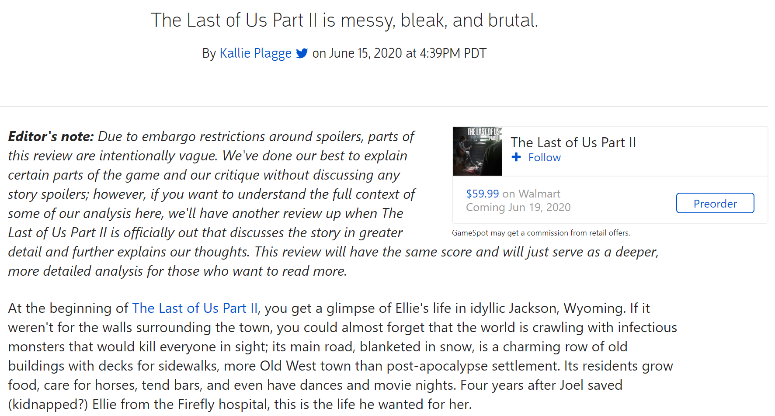



Slide 42
We must bring structure to unstructured data!

Slide 43
RegEx Assignment: Star Wars Script Tokenizer
Count the total number of words and the occurrence of each word.
Pre-made tokenizers are not allowed!
In 5-10 sentences describe the performance of your tokenizer.
Hint: hyphenated words, n-grams, contractions
Which of the following characters had the largest vocabulary? most dialogue (max number of words)?
Bonus points if you can visualize the results.
Darth Vader
Obi-wan Kenobi (Ben)
Luke Skywalker
Leia
Han Solo

